Slide 1

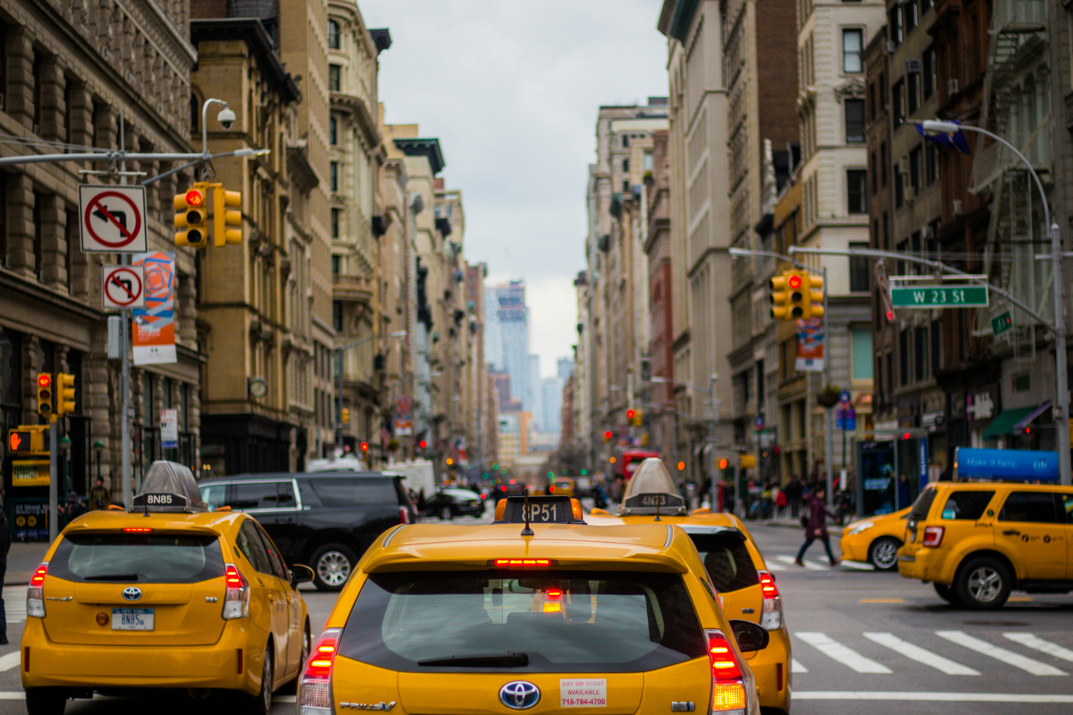

GoodCabs Analysis
Codebasics Resume Project Challenge - 13
Transportation & Mobility Domain
Functions - Operations
Presented By – Ajit Muni

Slide 2
Introduction
GoodCabs is a fast-growing cab service company that has earned a trusted reputation across India's tier-2 cities since its launch two years ago. By focusing on empowering local drivers, GoodCabs provides a stable livelihood for them in their hometowns while offering reliable and affordable transportation solutions to passengers.

Slide 3
GoodCab’s Goal
In 2024, GoodCabs aims to drive growth by increasing trip volumes, enhancing passenger satisfaction, and boosting repeat bookings. The company is focused on analyzing trip patterns and ensuring a healthy balance of new and returning passengers to strengthen its services further.

Slide 4
Datasets Provided
trips_dp
Tables
dim_city
dim_date
dim_repeat_trip_distribution
fact_passengers_summery
fact_trips
targets_dp
Tables
city_target_passenger_rating table
monthly_target_new_passengers
monthly_target_trips

Slide 5
Primary Analysis

Slide 6
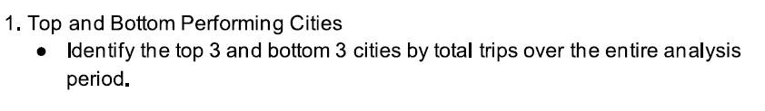
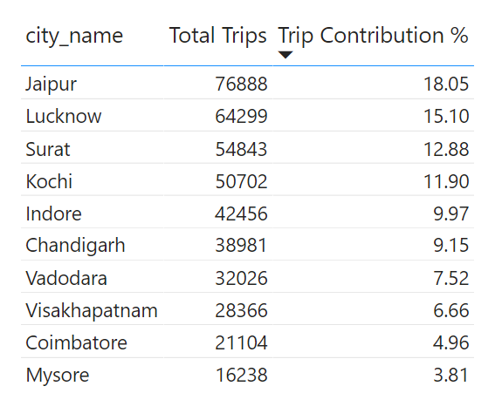
Primary Q1
Jaipur, Lucknow, and Surat have the highest number of trips, showing they are the busiest cities.
On the other hand, Visakhapatnam, Coimbatore, and Mysore record the lowest trips, indicating lower demand.

Slide 7
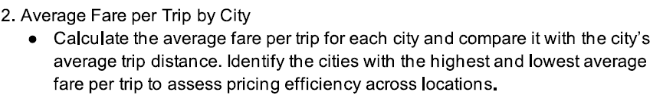
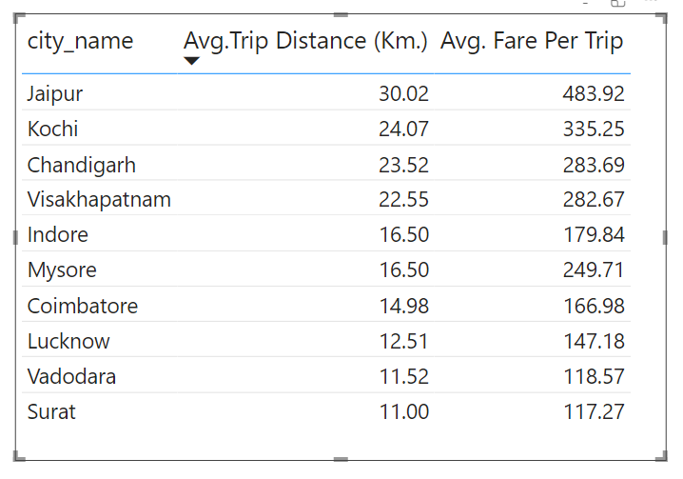
Primary Q2
Jaipur has the highest average fare per trip at ₹483.92 with an average distance of 30.02 km.
Surat has the lowest average fare at ₹117.27 and the shortest distance at 11.00 km.

Slide 8
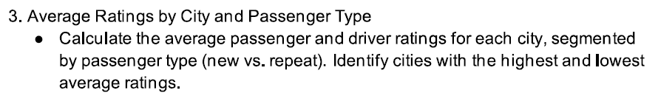
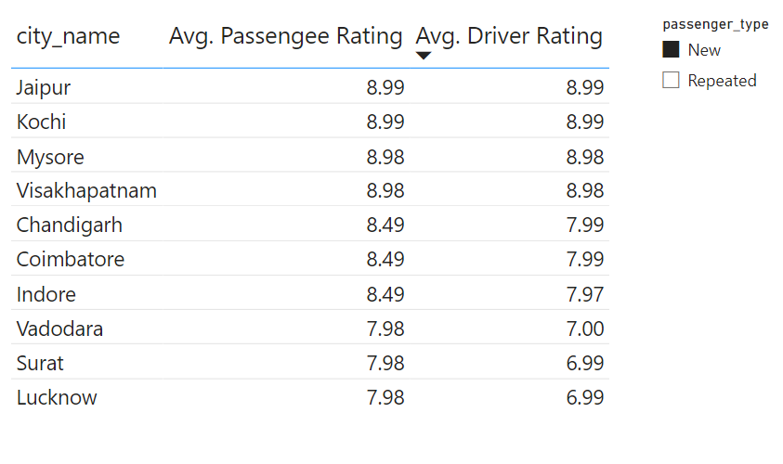
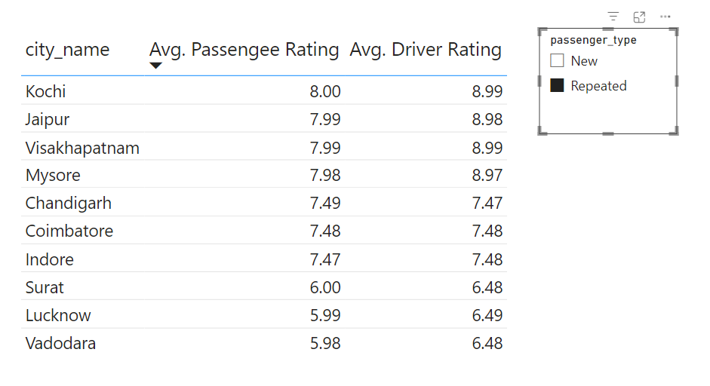
Primary Q3
Mysore stands out with the highest ratings for both passengers (8.70) and drivers (8.98).
Lucknow and Surat have the lowest ratings overall.
For different passenger types, Kochi and Jaypore score highest, while Lucknow and Vadodara score lowest.

Slide 9
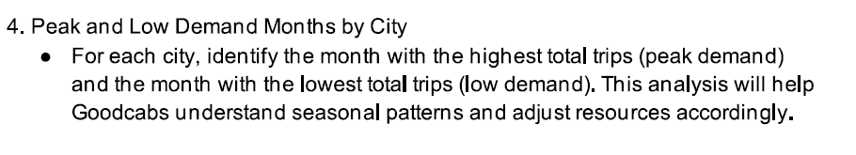
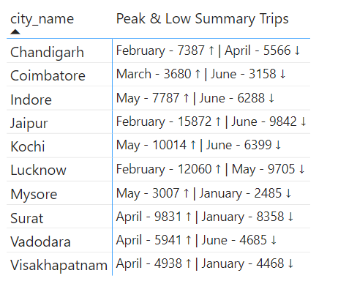
Primary Q4
February has the highest number of trips (15,872), while June has the lowest (9,842).

Slide 10
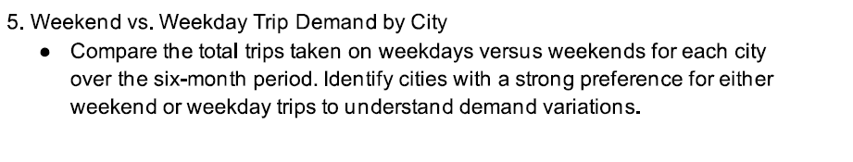
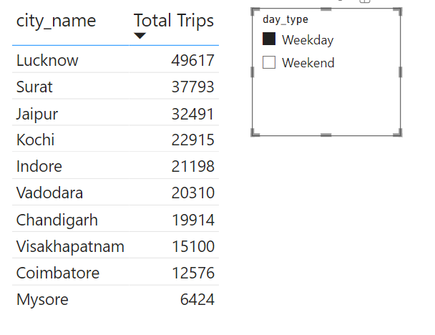
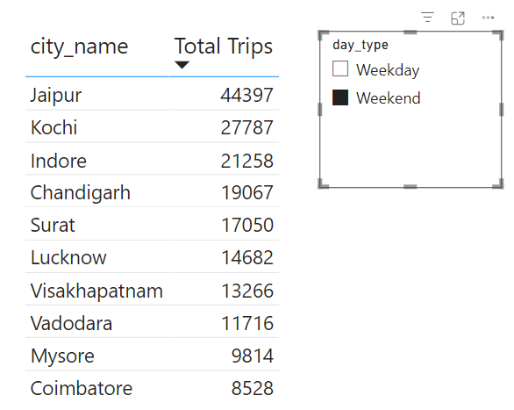
Primary Q5
On weekdays, Lucknow and Surat see the most trips since they are business-focused cities.
On weekends, Jaipur and Kochi lead the way, being popular tourist destinations

Slide 11
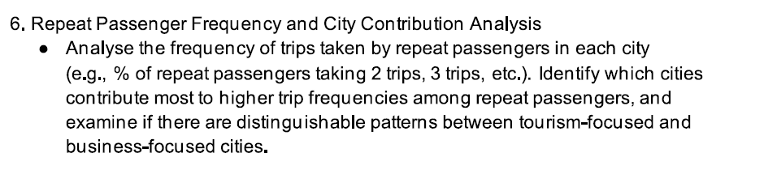
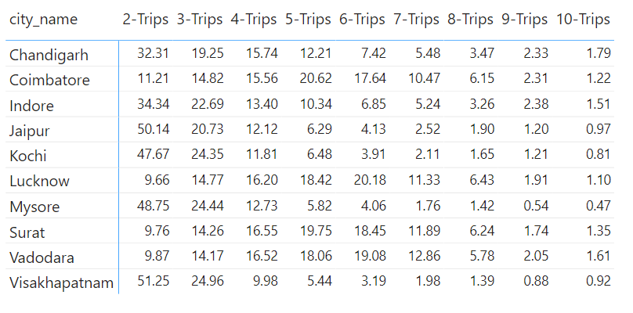
Primary Q6
In tourism-oriented cities (Jaipur, Kochi, Mysore, Visakhapatnam), passengers usually take 2-3 trips, likely for sightseeing.
In business-focused cities (Lucknow, Surat, Coimbatore, Vadodara), passengers often take 5+ trips, reflecting work-related travel.

Slide 12
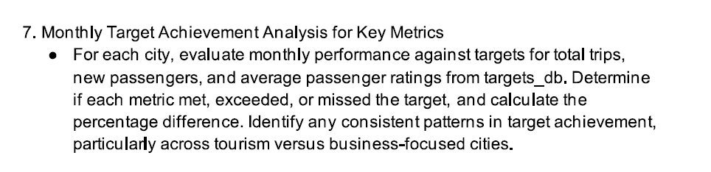
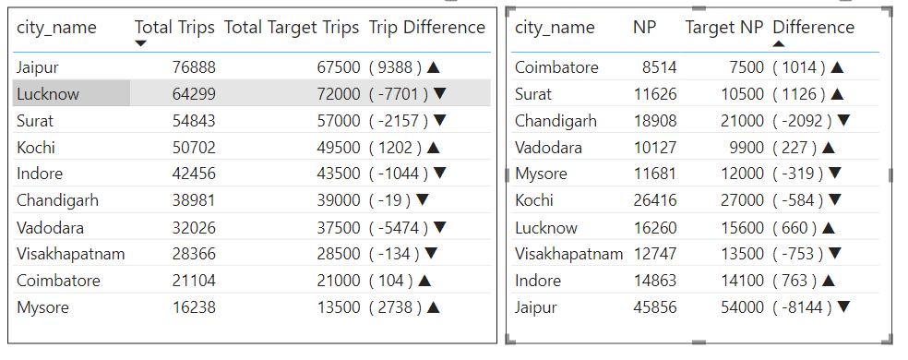
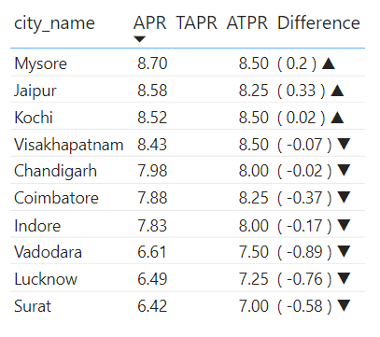
Primary Q7
Total Trips: Cities like Jaipur, Kochi, Coimbatore, and Mysore have exceeded their targets.
New Passengers: Lucknow, Indore, Surat, Vadodara, and Coimbatore performed well, exceeding their targets.
Passenger Ratings: Except for Jaipur, Kochi, and Mysore, most cities fell short of their rating targets.

Slide 13
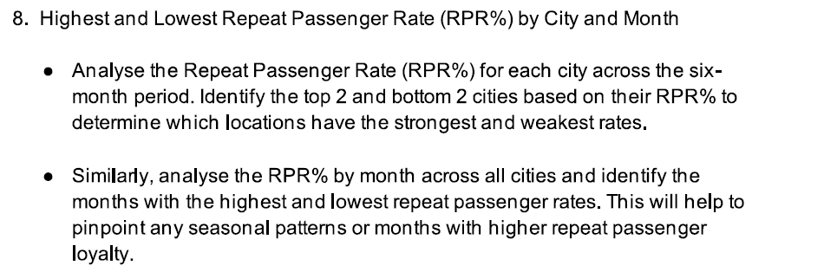
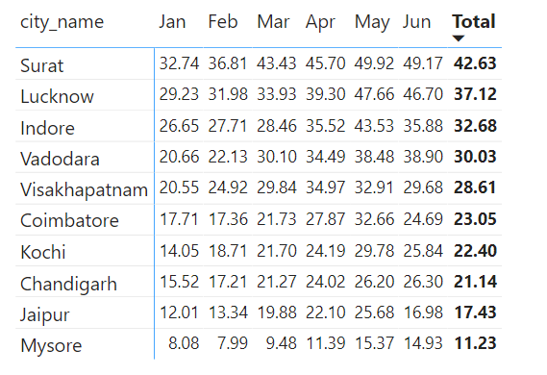
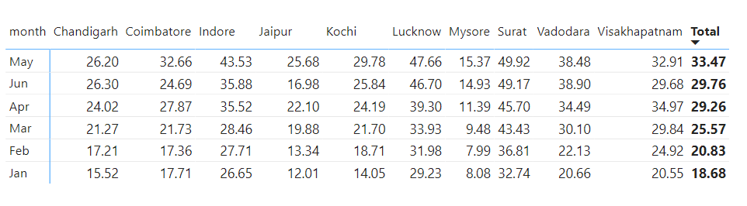
Primary Q8

Slide 14
Ad-Hoc Analysis

Slide 15
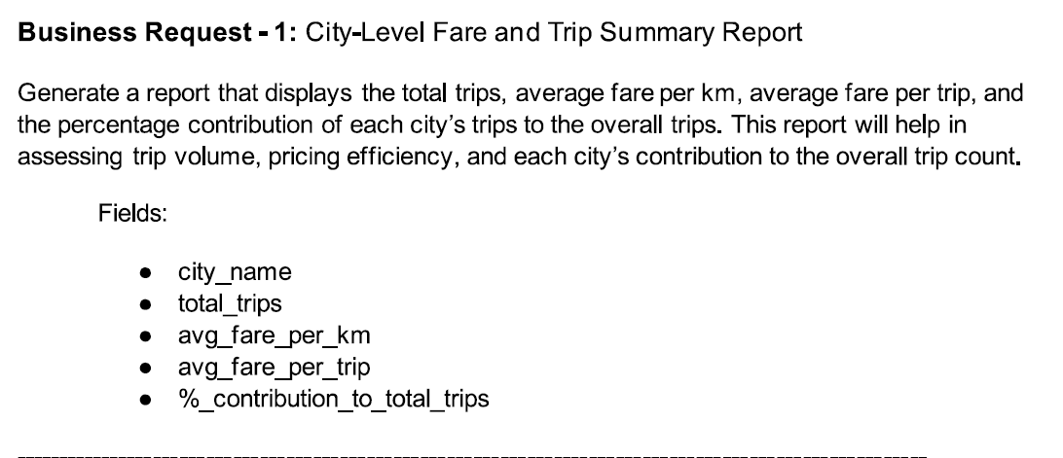
Ad-hoc Request -1

Slide 16
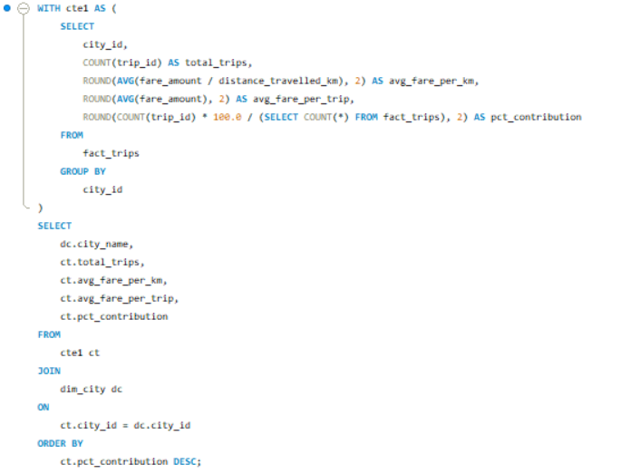
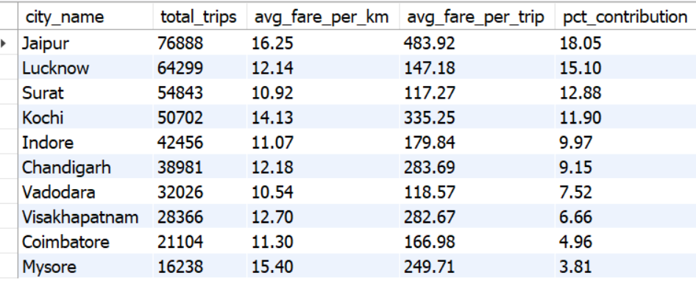
Query
Ad-hoc Request -1 Ans
Output

Slide 17
Ad-hoc – 1 Key Insights
Trip Contribution and Average Fare
Top Performers: Jaipur (18.05%), Lucknow (15.10%), and Surat (12.88%) contribute 46.03% of all trips.
Key Insight: Jaipur tops the chart with the highest average fare of ₹483.92 per trip.
Improvement Area: Mysore has the lowest contribution at 3.81% with 16,238 trips.

Slide 18
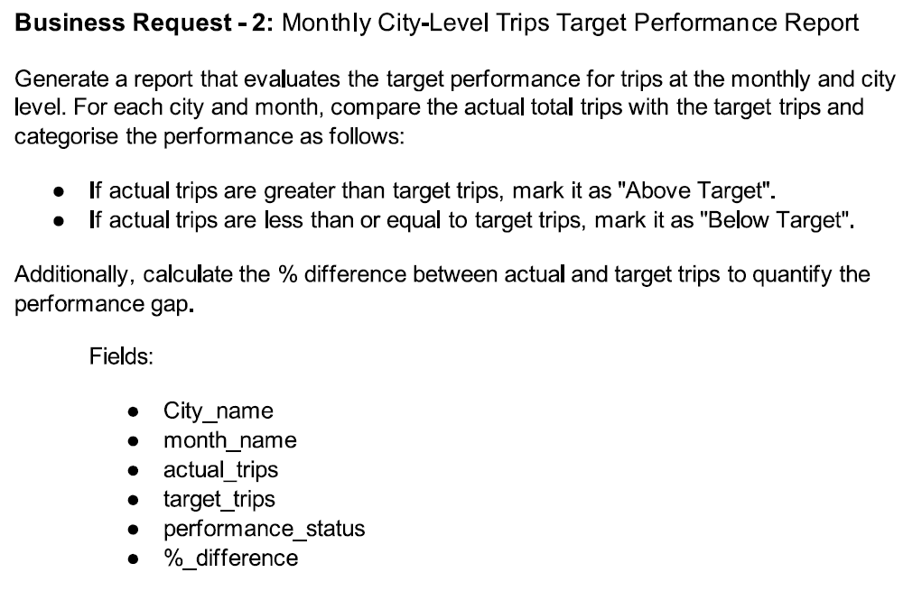
Ad-hoc Request -2

Slide 19
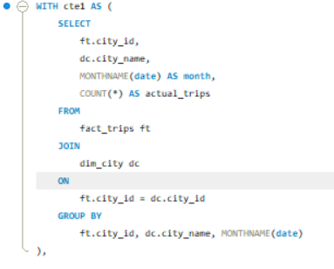
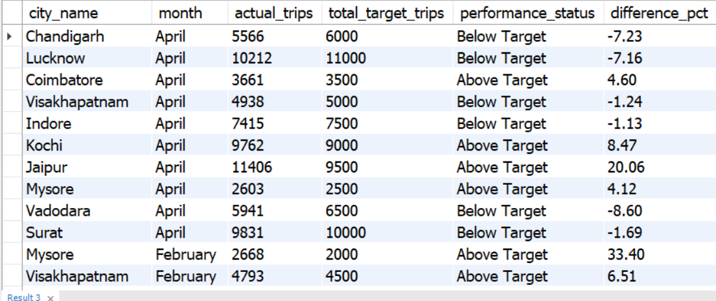
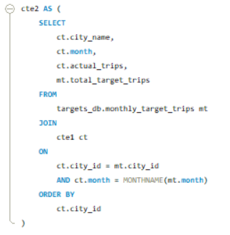
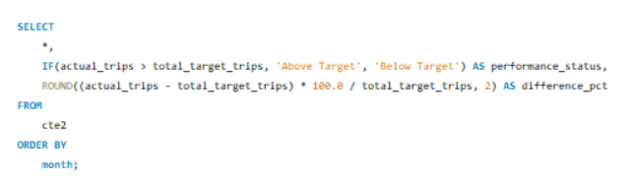
Query
Ad-hoc Request -2 Ans
Output

Slide 20
Ad-hoc – 2 Key Insights
Performance Analysis
High Achiever: Jaipur surpasses targets, especially in February (+22.09%) and May (+20.79%).
Underperformers: Vadodara (-27.92%) and Kochi (-28.9%) faced challenges in June.
Seasonal Trends: April and May see strong performances, while June highlights weak spots for Vadodara and Kochi.

Slide 21
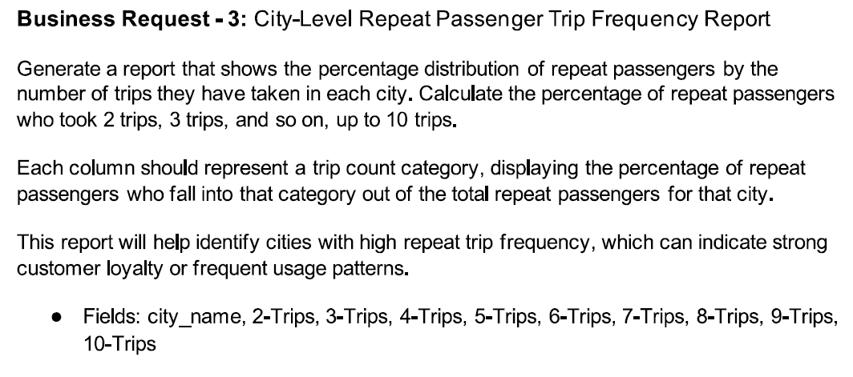
Ad-hoc Request -3

Slide 22
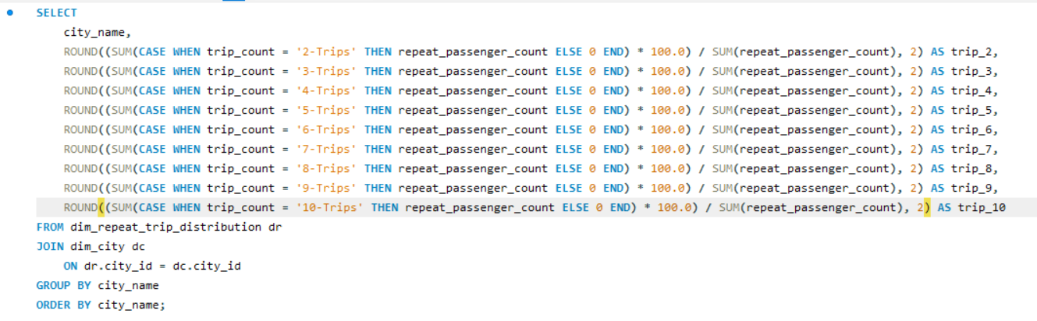
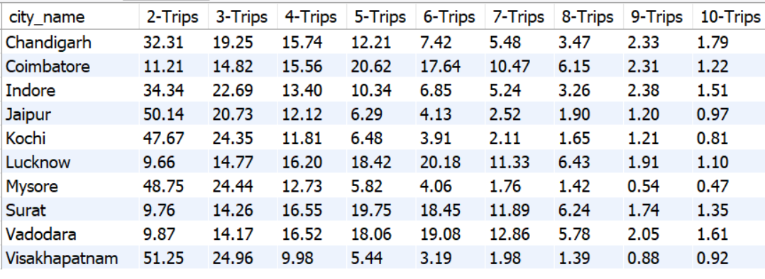
Query
Ad-hoc Request -3 Ans
Output

Slide 23
Ad-hoc – 3 Key Insights
Travel Patterns
Tourism Impact: Jaipur, Kochi, Mysore, and Visakhapatnam exhibit a high repeat passenger rate for initial trips (Trip-2 and Trip-3), leveraging their appeal as tourism hubs.
Consistency Observed: Cities like Indore, Lucknow, Surat, and Vadodara demonstrate steady repeat passenger contribution percentages across Trips 2 through 7, indicating consistent retention over a longer duration.
Key Takeaway: While tourism cities experience a strong start in repeat rates, other cities maintain balanced and sustainable growth across multiple trips.

Slide 24
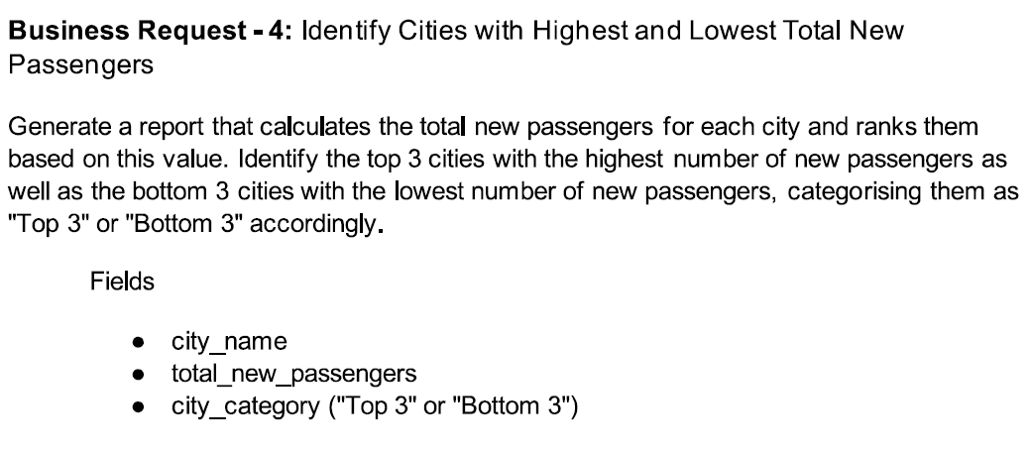
Ad-hoc Request -4

Slide 25
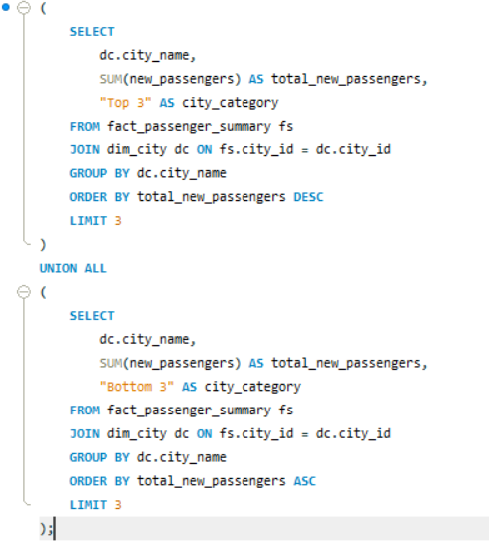
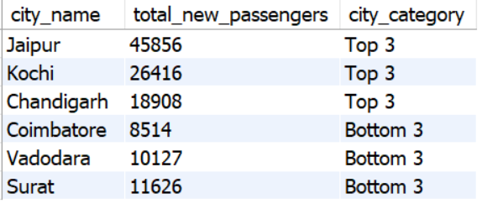
Query
Ad-hoc Request -4 Ans
Output

Slide 26
Ad-hoc – 4 Key Insights
New Passenger Growth
Jaipur leads with 45,856 new passengers.
Kochi follows in second place with 26,416 new passengers.
Chandigarh comes in third with 18,908 new passengers.
Jaipur outpaces the other cities by a significant margin, showing a clear dominance in attracting new passengers.

Slide 27
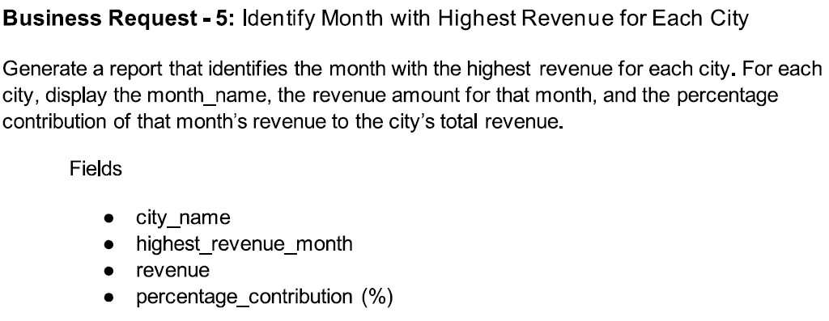
Ad-hoc Request -5

Slide 28
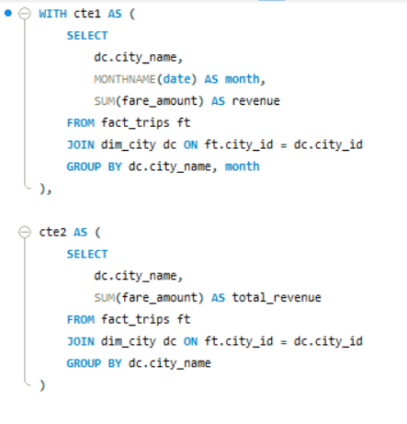
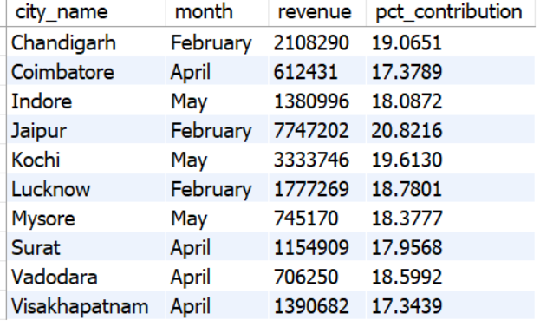
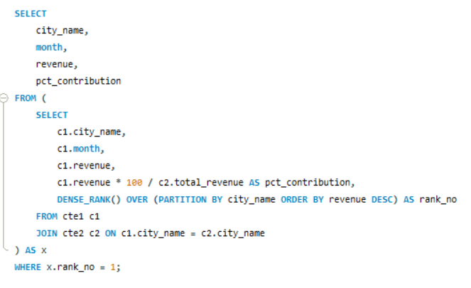
Query
Ad-hoc Request -5 Ans
Output

Slide 29
Ad-hoc – 5 Key Insights
City Name | Month | Revenue | Pct Contribution
Chandigarh | February | 2108290 | 19.07
Coimbatore | April | 612431 | 17.38
Indore | May | 1380996 | 18.09
Jaipur | February | 7747202 | 20.82
Kochi | May | 3333746 | 19.61
Lucknow | February | 1777269 | 18.78
Mysore | May | 745170 | 18.38
Surat | April | 1154909 | 17.96
Vadodara | April | 706250 | 18.60
Visakhapatnam | April | 1390682 | 17.34
Revenue Insights
Star Performer: Jaipur generates ₹7.7 million in February, accounting for over 20% of its annual revenue in a single month.
Seasonal Highlights: February, April, and May emerge as key revenue months for most cities.
Opportunity: Promotions during these months can amplify revenue growth.

Slide 30
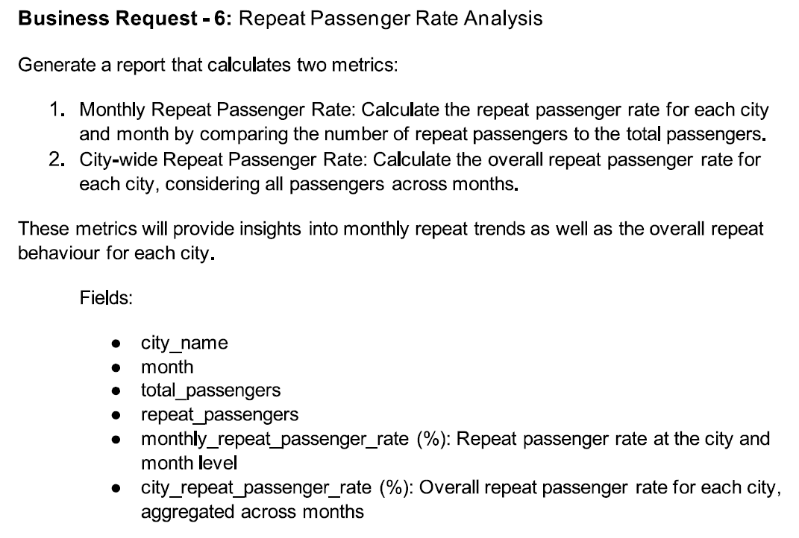
Ad-hoc Request -6

Slide 31
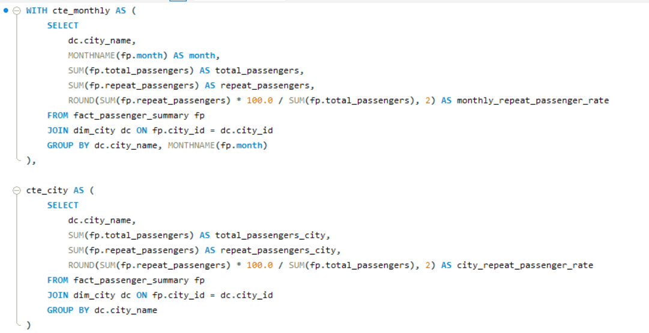
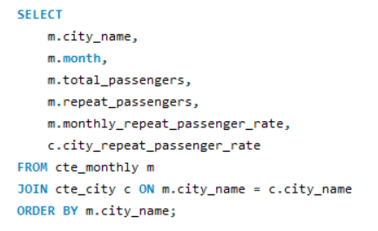
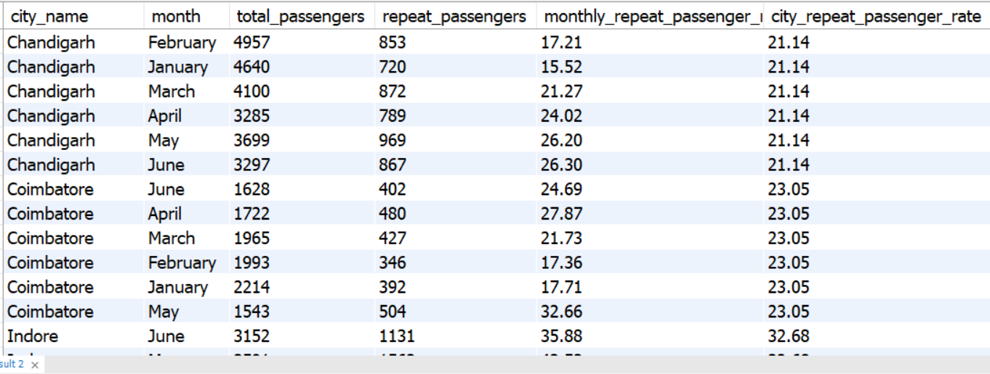
Query
Ad-hoc Request -6 Ans
Output

Slide 32
Ad-hoc – 6 Key Insights
Repeat Passenger Loyalty
Top Loyalty Cities: Surat (42.63%) and Lucknow (37.12%) lead in repeat rates, peaking in May and June.
Low Loyalty Cities: Mysore (11.23%) and Jaipur (17.43%) need improved retention strategies.
Trend Alert: May and June show high loyalty, likely tied to summer travel and promotions.

Slide 33
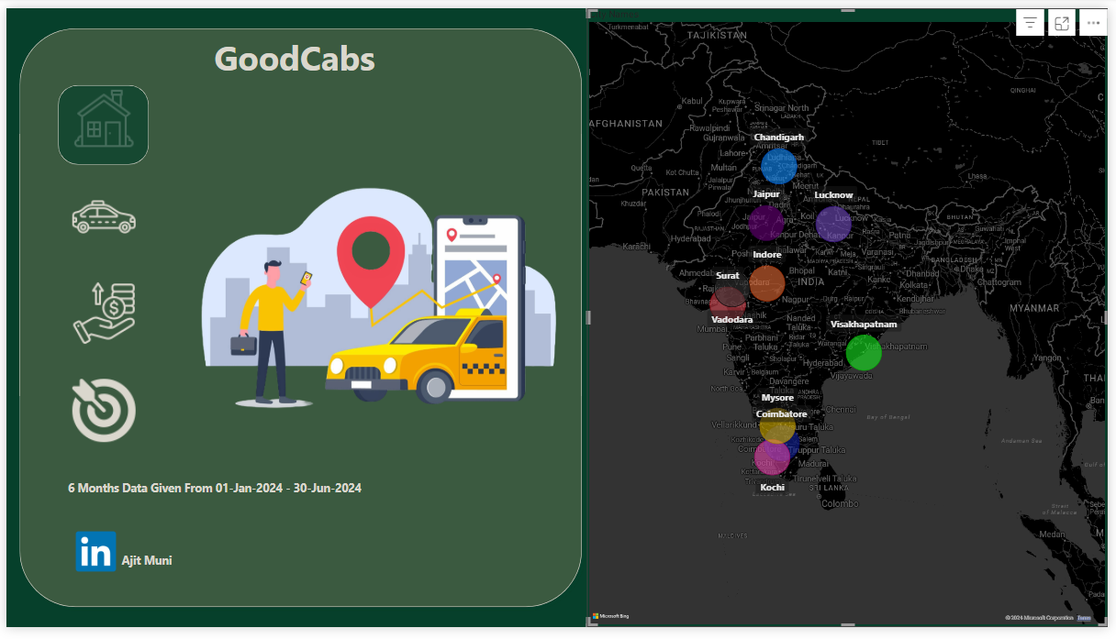
Dashboard Over

Slide 34
Secondary Analysis

Slide 35
Factors Influencing Repeat Passenger Rates
Surat and Lucknow have the highest repeat passenger rates, which can be attributed to their business-oriented nature. Frequent work-related travel likely drives repeat bookings.
Jaipur and Mysore, with the lowest repeat passenger rates, are more tourism-driven, where travelers are less likely to book frequently in a short span.

Slide 36
Tourism vs. Business Demand Impact
Weekdays: Cities like Lucknow and Surat see the highest number of trips due to business activity, as these cities attract corporate travel.
Weekends: Jaipur and Kochi have the highest trip volumes, driven by tourism, where people often travel for leisure or events during weekends.

Slide 37
Emerging Mobility Trends and Adaptation
With rising trends in eco-friendly travel (like EV adoption), cities such as Jaipur and Kochi can focus on integrating electric vehicles to appeal to tourists looking for sustainable travel options.
Business hubs like Surat and Lucknow could also consider green initiatives to stay competitive and meet corporate sustainability goals.

Slide 38
Improving Passenger and Driver Ratings
Mysore stands out with the highest ratings (Passenger: 8.70 | Driver: 8.98), showcasing good service quality.
In contrast, Lucknow and Surat show the lowest ratings, indicating a need for improvement in driver behavior, service quality, or overall experience.
Cities like Kochi and Jaipur perform well for specific passenger types, suggesting targeted improvements could raise ratings in underperforming cities.

Slide 39
Trip Targets and Performance
Total Trips:
Cities like Jaipur, Kochi, Coimbatore, and Mysore have exceeded targets, showing strong demand.
Other cities are below target, requiring focused marketing campaigns or service improvements.
New Passenger Targets:
Cities like Lucknow, Indore, Surat, Vadodara, and Coimbatore have exceeded targets.
Passenger Ratings:
Except for Jaipur, Kochi, and Mysore, all other cities are below target, showing a need for service-level improvements.

Slide 40
Monthly and Seasonal Trends
Jaipur sees the highest number of trips in February (15,872), likely due to peak tourism events or favorable weather.
June has the lowest trips (9,842), possibly due to the off-season for tourism.
May has the highest repeat passenger rate, suggesting seasonal promotions or events driving repeat travel.
January sees the lowest repeat passenger rate, likely due to post-holiday slowdowns.

Slide 41
Business vs. Tourism Cities
Tourism-Oriented Cities: Visakhapatnam, Mysore, Jaipur, and Kochi have higher repeat trips for 2-3 travel patterns, indicating leisure-based repeat visits.
Business-Focused Cities: Coimbatore, Lucknow, Surat, and Vadodara see more frequent travel patterns with 5+ trips, showing work-related travel demands.

Slide 42
Data Collection for Enhanced Data-Driven Decisions
To make GoodCabs a truly data-driven company and optimize key metrics like repeat passenger rate, customer satisfaction, trip volume, and new passengers, expanding data collection across four key areas will provide actionable insights:
Customer Behavior: Track booking preferences (time/day/month), trip purpose (business vs. leisure), and payment methods (cash, digital, loyalty programs) to better align services with passenger needs.
Operational Efficiency: Monitor driver performance (ride duration, punctuality, cancellations), idle time, and route efficiency to improve availability and trip optimization.
Customer Feedback: Collect ride experience ratings, analyze post-ride complaints, and use sentiment analysis tools to identify and address recurring issues.
Market Trends: Analyze competitor strategies, identify demand hotspots, track emerging trends (like EV adoption), and factor in seasonal, event-based, and weather influences to predict spikes in demand.
GoodCabs can deliver personalized services, optimize operations, and stay competitive by focusing on these areas, ensuring long-term growth and customer satisfaction.

Slide 43

ajit.muni@outlook.com
Thank You
+91 7064649974
Ajit Muni

